Slide 1
ENDANGERED ANIMALS WEBSITE
Jesús Reyes de Toro a042755
Rafael Fernandez Nevado a043243
https://whimsical-sunburst-d3c632.netlify.app/

Slide 2
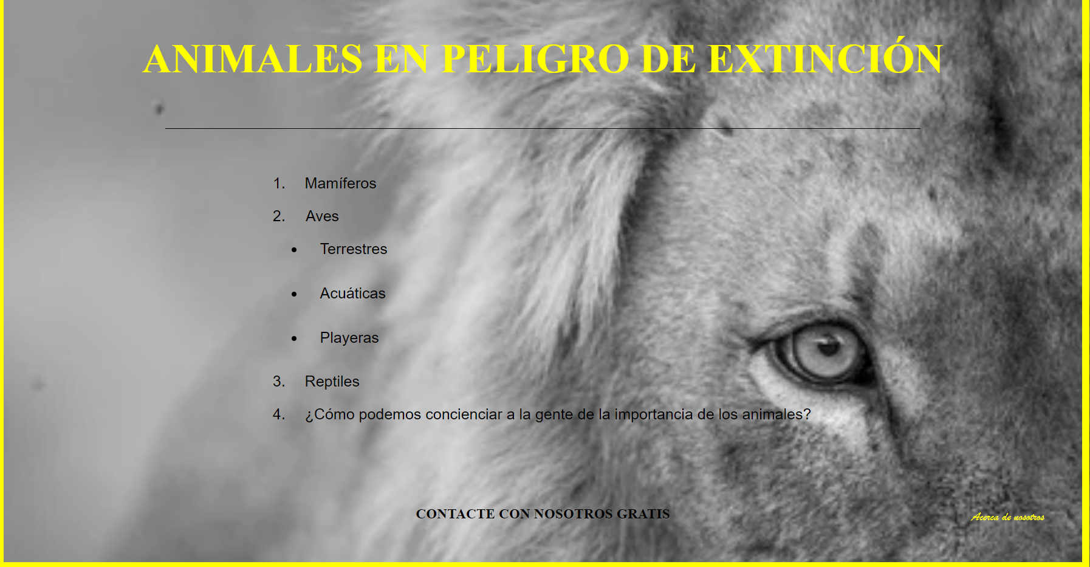
INDEX
1. A little presentation
2. User Interface
2.1 Mammals
2.2 Birds
2.3 Reptiles and consciousness
2.4 Draft and Sitemap
3. Product
3.1 Product description
3.2 How to installate and configurate it
3.3 The form
3.4 Validation of html and css pages

Slide 3
A little presentation
To make this project we have used the endangered animals theme. It is very important to give information about this because it is becoming a real preoccupation lately.
The structure of our website is based on different subclasses of animals. We have divided it on Mammals, Birds and Reptiles. Then we talk about consciousness of endangered animals.
Inside any topic, we have some descriptions of some specific animals, some audios to show you how these animals sounds, images to see the animals we are talking about and some videos.

Slide 4
2. User Interface

Slide 5
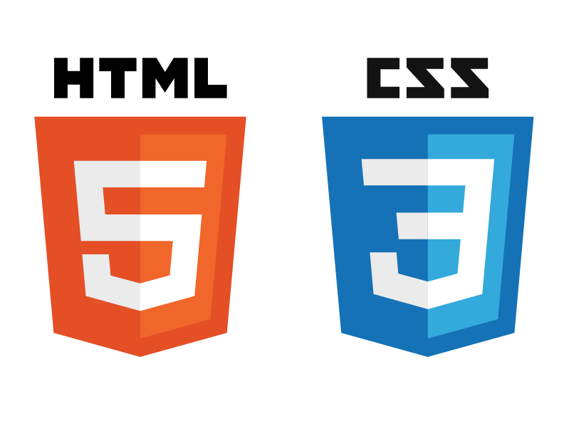
2. User Interface
To do the project we have used HTML and CSS. We have made a simple interface with some photos and a simple organisation. It is an intuitive interface and we think it is hard to get lost

Slide 6
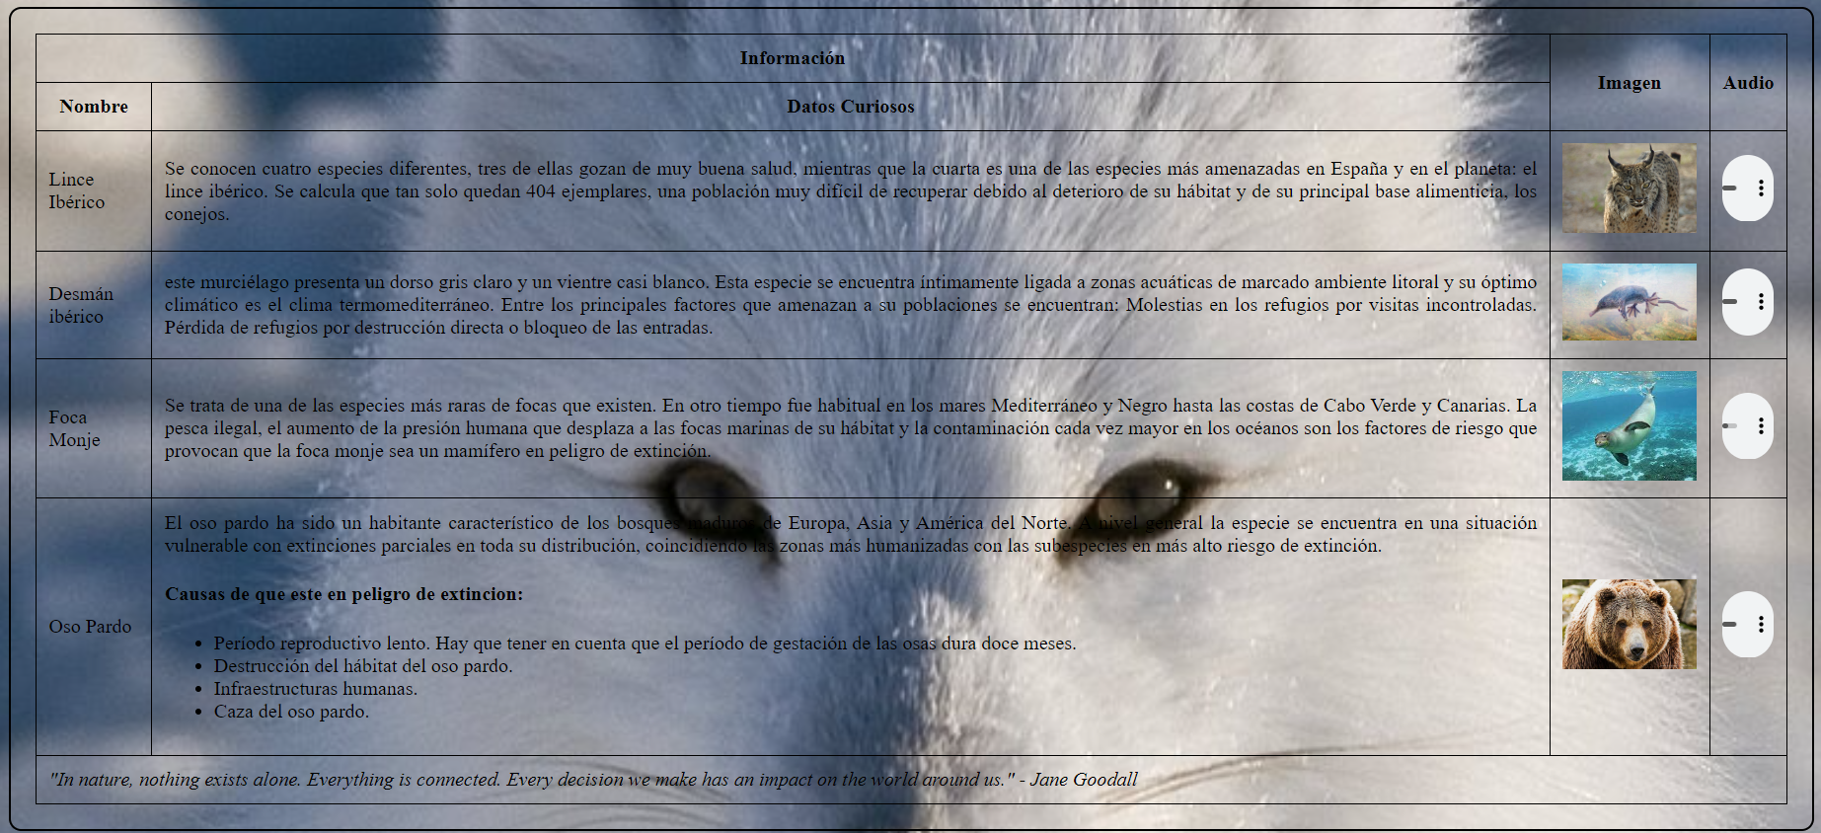
2.1. Mammals
To do the mammals interface we have used some tables and an unordered list. We have also used some videos and audios to show with only a click you can hear the sounds.

Slide 7
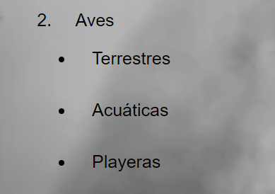
2.2. Birds
For the birds webpage we divided it into 3 types and we used two different styles for this section. For the terrestrial and aquatic section we used a similar style as the mammals one. For the beach birds section we used a different style. It is a more common style

Slide 8
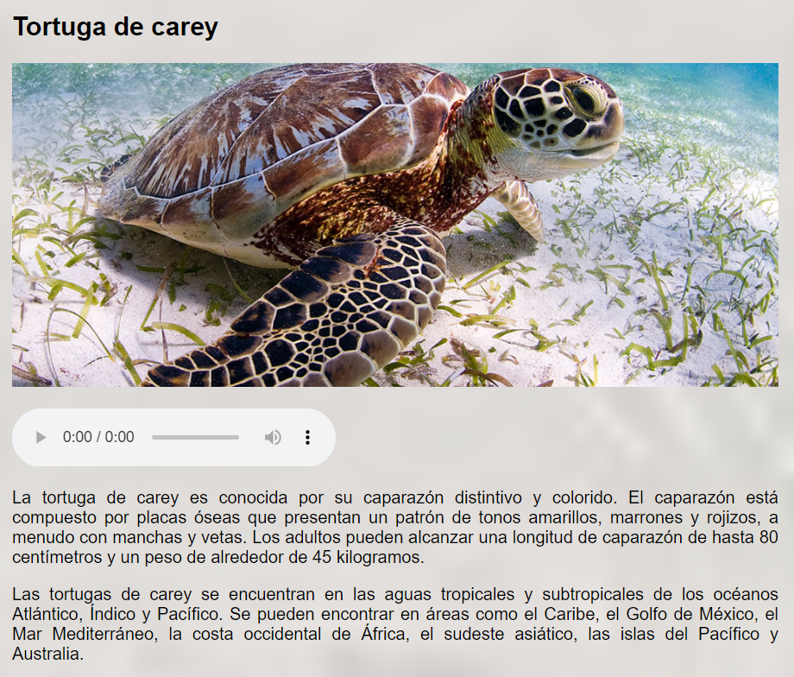
2.3. Reptiles and consciousness
On the reptile section we used the same schema as we used on the last birds’ page.
It is a very simple but intuitive way to do it.
And for the consciousness webpage we used another kind of structure, also very common in other web pages and blogs.

Slide 9
2.4. Draft and sitemap
The draft was a way to see how the page was gonna be.
We thought to do it in many different ways but the draft we have is the more similar to the webpage we finally did
A Sitemap is a file that contains a list of all the pages published when you create a website.
Sitemaps contain the following information about each page:
The location (i.e. URL)
Last modification date

Slide 10
3. PRODUCT

Slide 11
3.1 Product description
In this project we are going to make our website about some of the endangered animals, the
main causes of their extinction or almost extinction and how some enterprises are trying to
protect them and how they explain to us to support to protect them.
We are also going to talk about some laws and some countries that "contribute" on the
extinction of some animals, giving reasons of why we should be aware of this problem

Slide 12
3.2 How to installate and configurate it
First of all, we need to create a netlify account in https://app.netlify.com/signup
We connect to our GitHub profile. This step is essential to deploy web pages and is helpful to do automatic deployments from our repository.
We access production deploys and now we can download the web page.
https://app.netlify.com/teams/jreyeess/overview

Slide 13

3.3 The form
What is Formspree
How we use Formspree in order to build our web page form
https://formspree.io/forms/xpzegekp/integration
How the form validate the data

Slide 14
3.4 Validation of html and css pages
https://validator.w3.org/

